Slide 1
Creating Azure Resource Manager virtual machines in Azure
Creating virtual machines by using the Azure portal and Azure PowerShell
Validating virtual machine creation

Slide 2
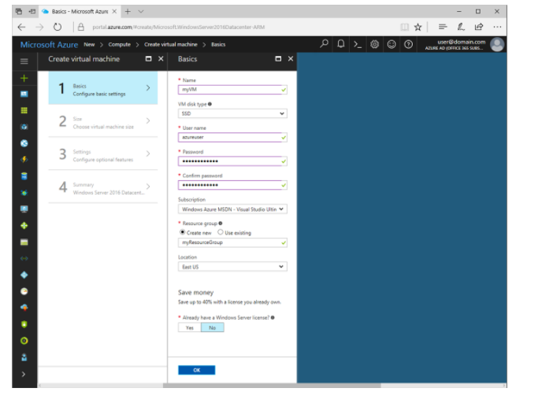
Creating virtual machines by using the Azure portal and Azure PowerShell
Click the New button found on the upper left-hand corner of the Azure portal.
Select Compute, and then select Windows Server 2016 Datacenter.
Enter the virtual machine information. The user name and password entered here is used to log in to the virtual machine. When complete, click OK.

Slide 3
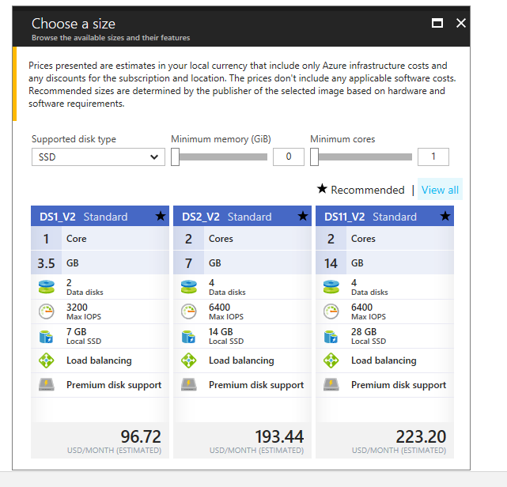
Select a size for the VM. To see more sizes, select View all or change the Supported disk type filter.

Slide 4
Under Settings, keep the defaults and click OK.
On the summary page, click Ok to start the virtual machine deployment.
The VM will be pinned to the Azure portal dashboard. Once the deployment has completed, the VM summary automatically opens.

Slide 5
Validating virtual machine creation
You can develop Azure-based VMs on Windows or Linux. Some elements of the publishing process--such as creating an Azure-compatible virtual hard disk (VHD)--use different tools and steps depending on which operating system you are using

